Slide 1

Sensor Kit (Kit 1) ZAS Robotics Training

Slide 2

Sensors Kit (Kit 1) Training - Objectives
Review the Contents in the Box
Review & Discuss the Sensors Creative Board
Discuss the Health & Safety Precautions, Power Supply and Sensor Modules V/G Pins
Conduct the Following Labs on both the Bread Board and Creative Board
Lab S1: Ultrasonic Sensor (HC-SR04)
Lab S2: Ultrasonic Sensor (HC-SR04) with OLED
Discuss the Bread Board feature of the Creative Board
Discuss the Free Connector Concept of Creative Board
Conduct the Following Lab on the Bread Board feature of the Creative Board
Lab S3: Air Quality (MQ-135) Sensor with OLED

Slide 3
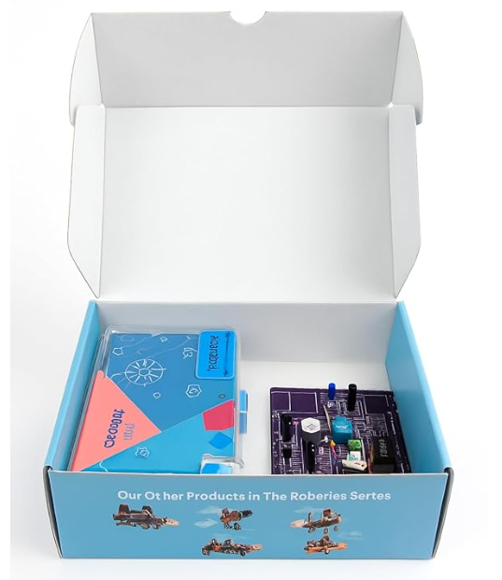
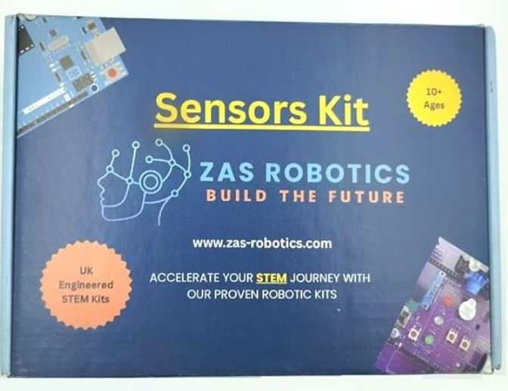
ZAS Robotic Products – Sensors Kit

Slide 4

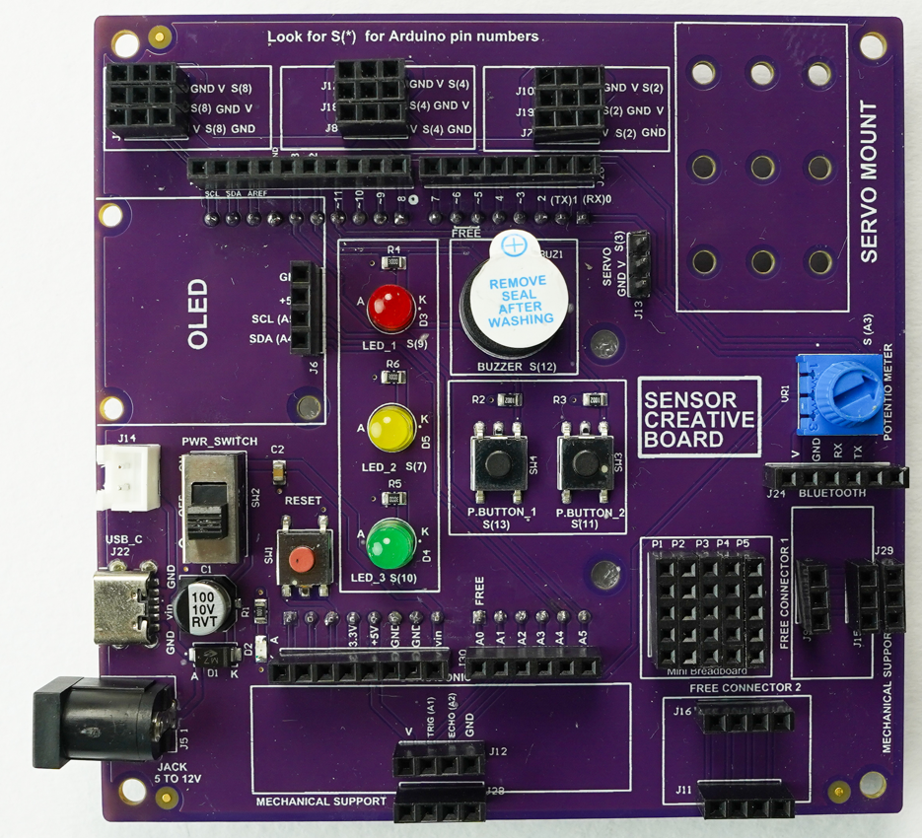
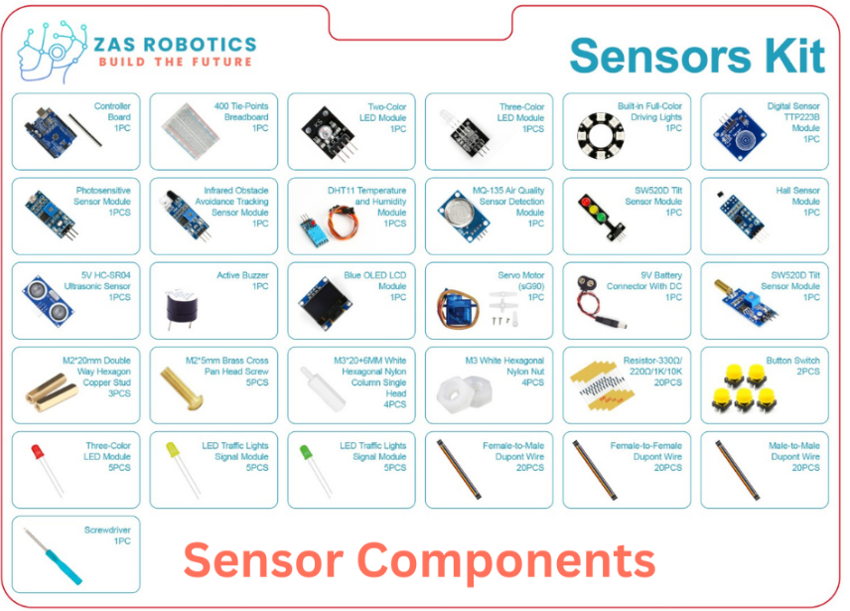
Sensor Kit - Contents
Sensor Kit Components
Sensor Creative Board

Slide 5
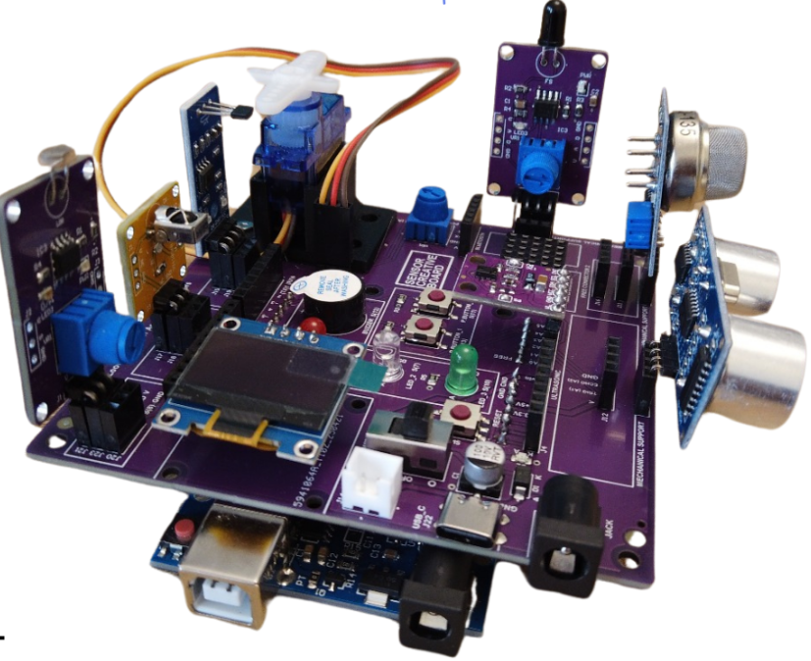
Kit 1 Sensor Creative Board
Sensor Creative Board – Bare Board
Sensor Creative Board – Sensors Mounted

Slide 6
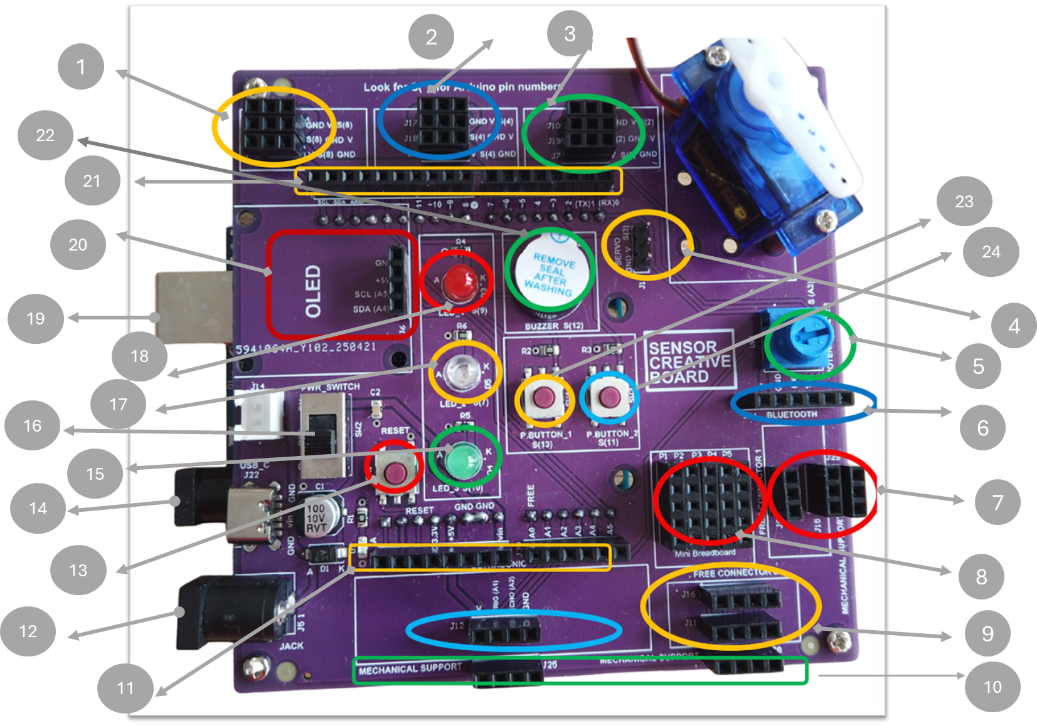
Kit 1 Sensor Creative Board Features

Slide 7
Kit 1 Sensor Creative Board Features
# | Notes
1 | 3 Pin Sensor Connector Connected to Arduino PIN 8
2 | 3 Pin Sensor Connector Connected to Arduino PIN 4
3 | 3 Pin Sensor Connector Connected to Arduino PIN 2
4 | 3 Pin Servo Connector Connected to Arduino PIN 3
5 | Potentiometer Connected to Arduino PIN A3
6 | Bluetooth Connector Connected to Arduino Tx/Rx PINS
7 | 3 PIN Sensor Connector – FREE or NOT Connected to Any of the Arduino PINS
8 | 5x5 Mini Breadboard giving you the flexibility to add your own sensors
9 | 4 PIN Sensor Connector – FREE or NOT Connected to Any of the Arduino PINS
10 | Mechanical Supports to Ultrasonic and 4 Pin Sensors
11 | Arduino PINS
12 | DC Power Supply to ZAS Creativity Board
# | Notes
13 | RESET button for Arduino
14 | DC Power Supply of the Arduino Board
15 | Green LED Connected to Arduino PIN 10
16 | On/Off Switch of the ZAS Creativity Board
17 | Yellow LED Connected to Arduino PIN 7
18 | Red LED Connected to Arduino PIN 9
19 | USB Programming Port of the Arduino
20 | OLED Connector Connected to Arduino SCL (A5), SDA (A4) Pins
21 | Arduino PINS
22 | Buzzer Connected to Arduino Pin 12
23 | Button Connected to Arduino Pin 13
24 | Button Connected to Arduino Pin 11

Slide 8
Health & Safety Precautions
Double-check all power connections Ensure correct GND and VCC wiring for the power supply, OLED, motor drivers, GPS, sensors, and other modules.
Use the correct input voltage Battery input should be between 5V and 12V only.
Work on a safe surface Use the kit on an insulated table (e.g., wood) and ensure the surface is dry and clean.
Avoid leaving the kit unattended Do not keep the system powered on without supervision.
Build and Test Incrementally Turn on the microcontroller first, then build and test the circuit step-by-step. Avoid wiring the entire system at once and powering it without intermediate testing.
18650 Battery Care– For long battery life, charge it at regular intervals. Avoid battery complete draining (going down to 0%), Do not leave the battery unattended while charging or charge it overnight. If the battery appears swollen, leakage or bulging, do not use it. Use a proper Li-ion charger, Dispose of faulty batteries safely and responsibly.

Slide 9
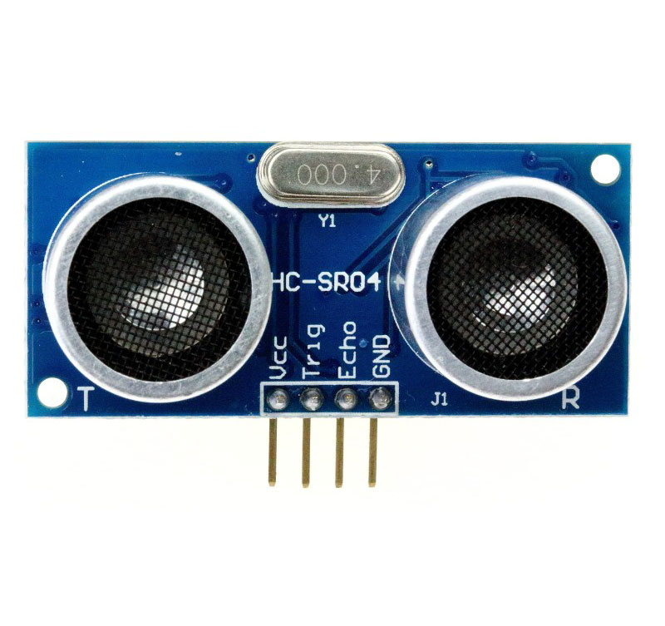
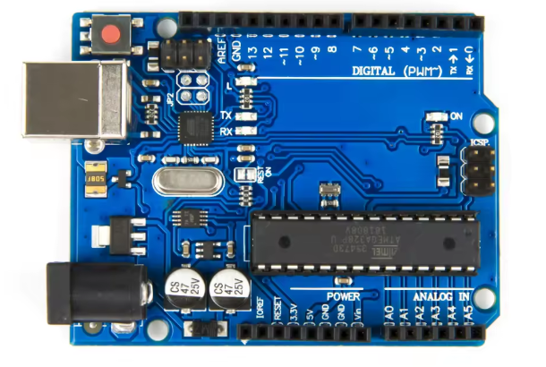
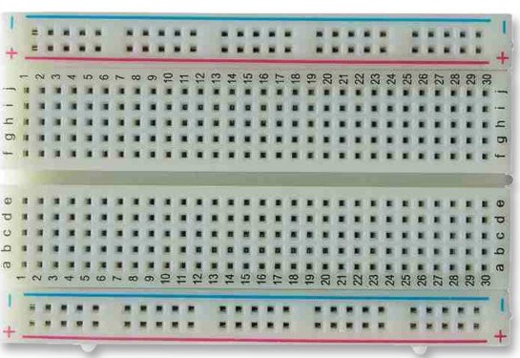
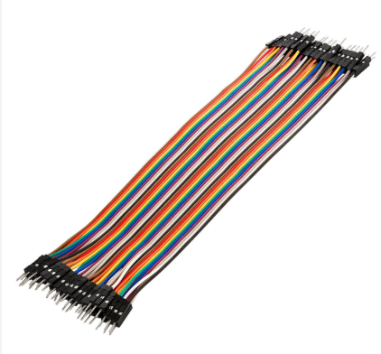
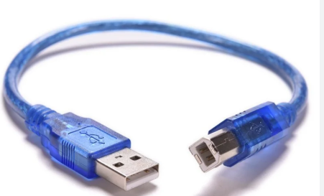
Lab S1: Ultrasonic Sensor
Things Needed

Slide 10
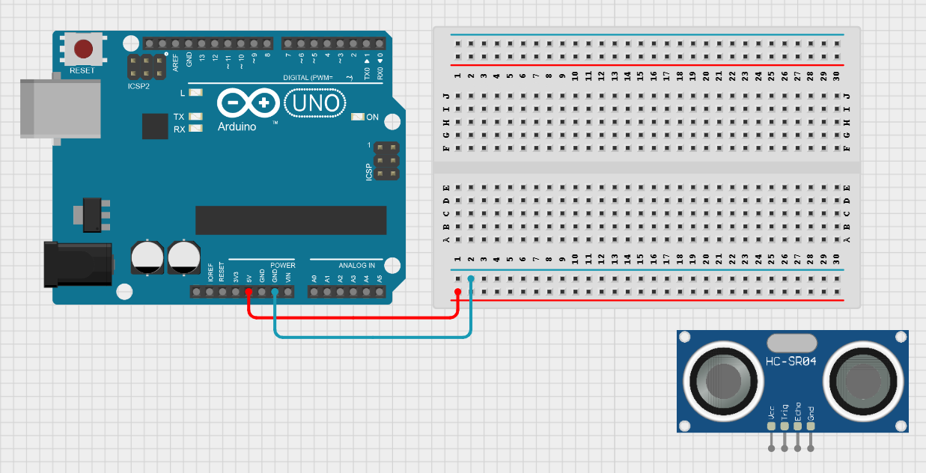
Lab S1: Ultrasonic Sensor
Step 1:
Make Power and GND connections

Slide 11
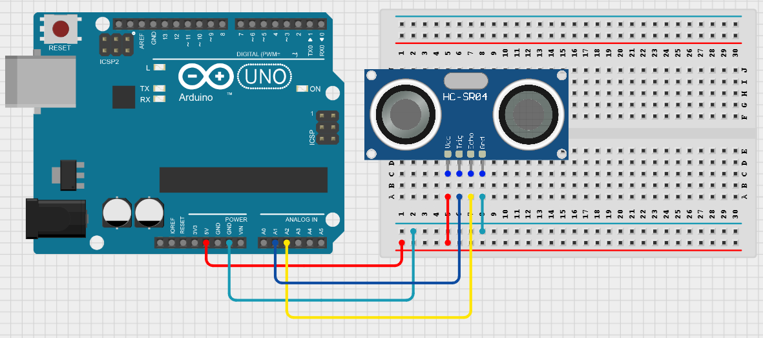
Lab S1: Ultrasonic Sensor
Step 2:
Make ultrasonic
connections

Slide 12
Lab S1: Ultrasonic Sensor
Code for Lab S1 (Breadboard)
setup()
Start Serial communication
Set ultrasonic pins: TRIG = OUTPUT, ECHO = INPUT
Set buzzer pin = OUTPUT
loop()
Trigger ultrasonic sensor: send 10 µs HIGH pulse on TRIG
Read echo duration using pulseIn()
Convert duration → distance (cm)
Update Serial Monitor: show “Distance:” and measured value
Overall Flow
Ultrasonic sensor measures distance
Serial Monitor continuously displays the distance
Code for Lab S1 (01_Sensors_Kit_Ultrasonic.ino):
https://github.com/info-zas/Training/tree/main/GPREC/01_Sensors/01_SensorsCode/01_Sensors_Kit_Ultrasonic

Slide 13
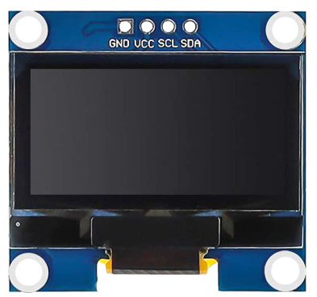
Lab S2: Ultrasonic Sensor with OLED
Adding OLED to Lab S1

Slide 14
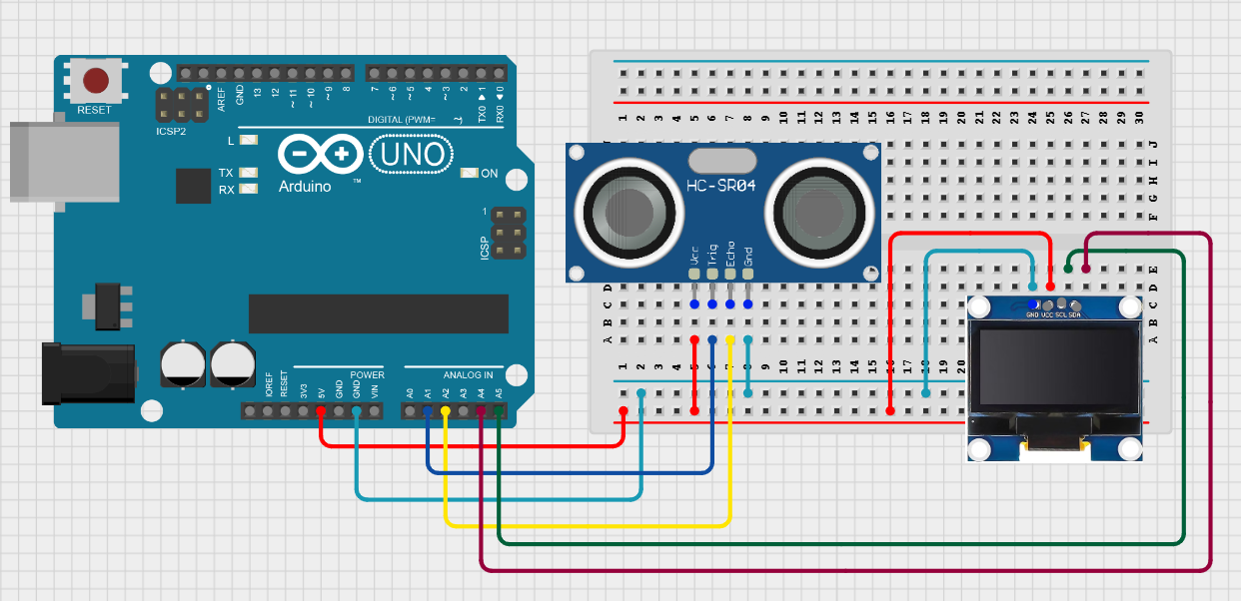
Lab S2: Ultrasonic Sensor with OLED
Make OLED
connections

Slide 15
Lab S2: Ultrasonic Sensor with OLED
Code for Lab S2 (Breadboard)
setup()
Start Serial communication
Set ultrasonic pins: TRIG = OUTPUT, ECHO = INPUT
Set buzzer pin = OUTPUT
Initialize the OLED display (I2C)
loop()
Trigger ultrasonic sensor: send 10 µs HIGH pulse on TRIG
Read echo duration using pulseIn()
Convert duration → distance (cm)
Update OLED: show “Distance:” and measured value
Buzzer logic: • If distance < 10 cm → play 1000 Hz tone • Else → stop tone
Delay for 1 second
Overall Flow
Ultrasonic sensor measures distance
OLED continuously displays the distance
Buzzer alerts when an object comes very close
Code for Lab S2 (02_Sensors_Kit_Ultrasonic_With_OLED.ino):
https://github.com/info-zas/Training/tree/main/GPREC/01_Sensors/01_SensorsCode/02_Sensors_Kit_Ultrasonic_With_OLED

Slide 16
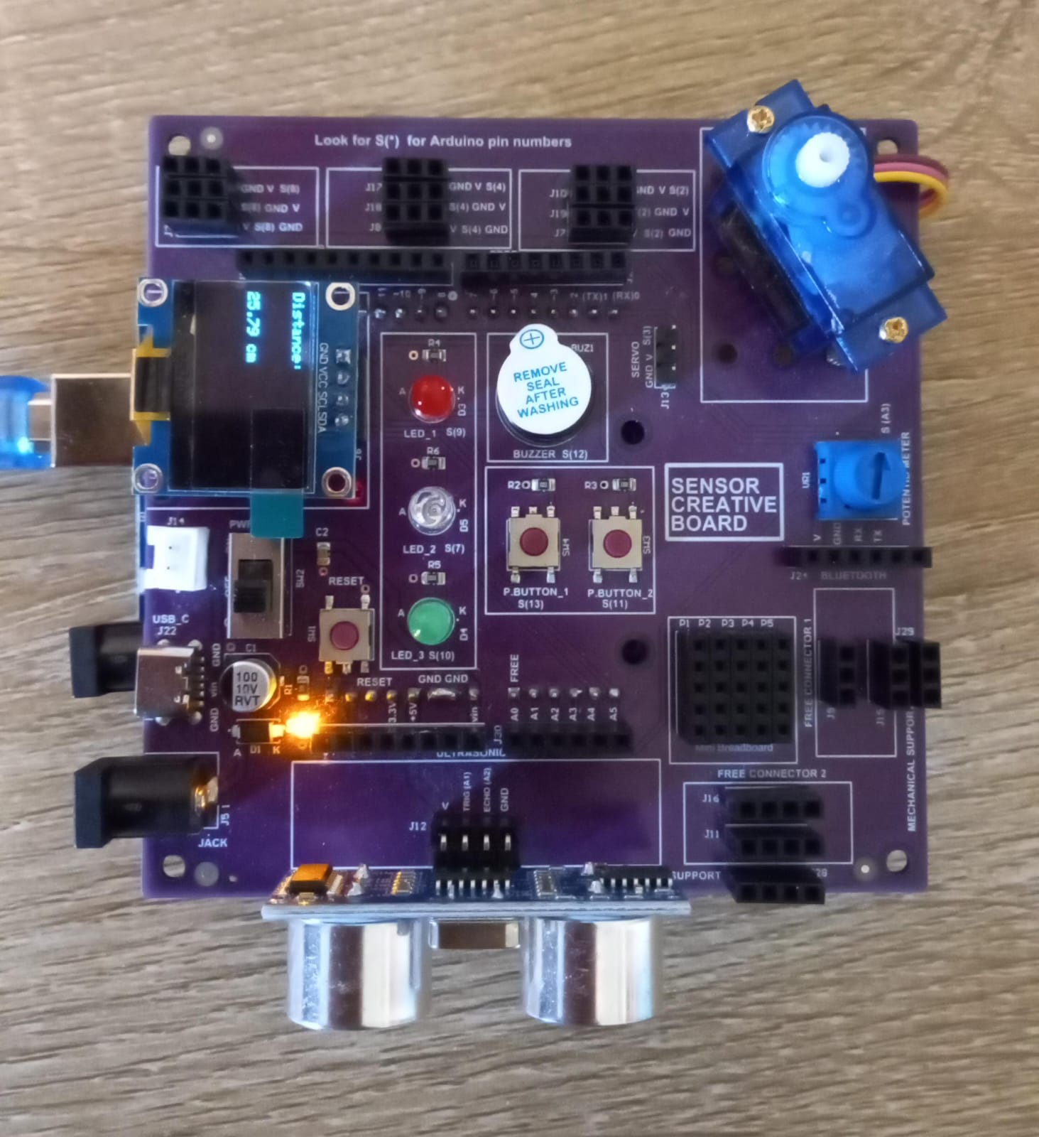
Lab S2: Ultrasonic Sensor with OLED
Creative board:
Ultrasonic in J12
OLED at J6
Code for Lab S2 (02_Sensors_Kit_Ultrasonic_With_OLED.ino):
https://github.com/info-zas/Training/tree/main/GPREC/01_Sensors/01_SensorsCode/02_Sensors_Kit_Ultrasonic_With_OLED

Slide 17
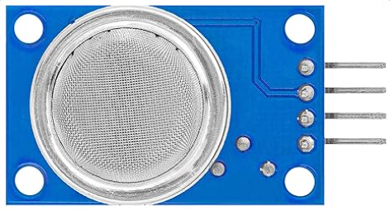
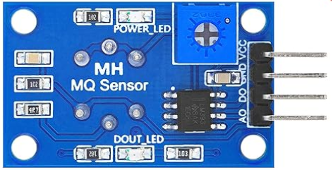
Lab S3: Air Quality Sensor with OLED
Things Needed
(Front)
(Back)
MQ-135 Sensor

Slide 18
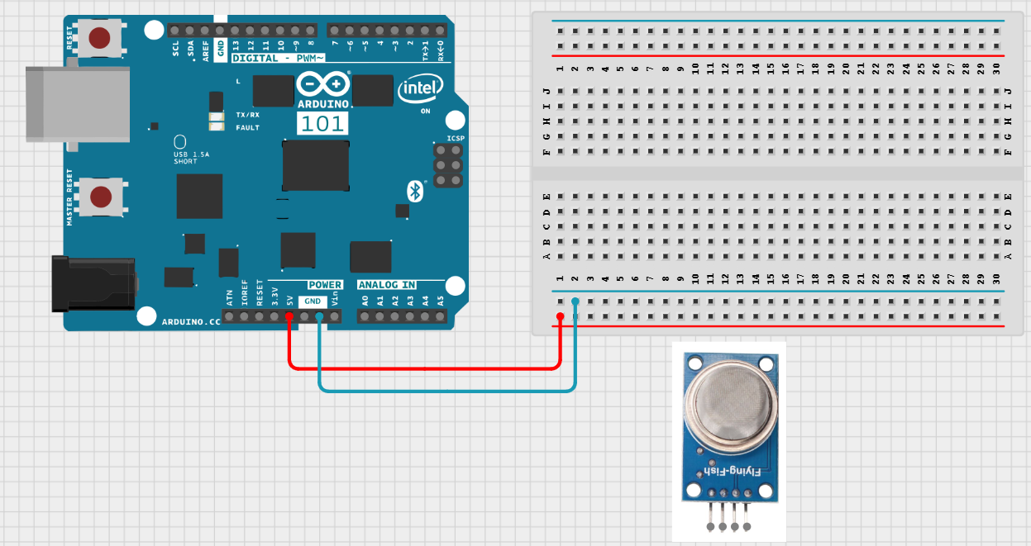
Lab S3: Air Quality Sensor with OLED
Step 1:
Make Power and GND connections

Slide 19
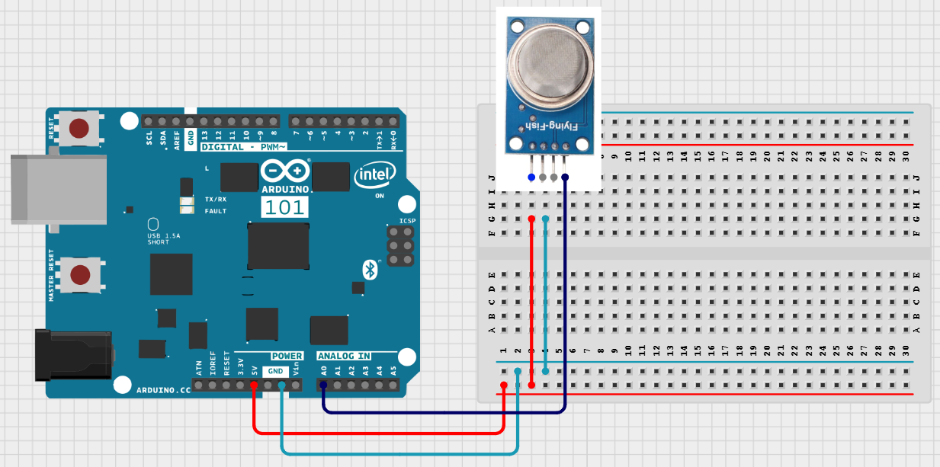
Lab S3: Air Quality Sensor with OLED
Step 2:
Make the gas sensor connections

Slide 20
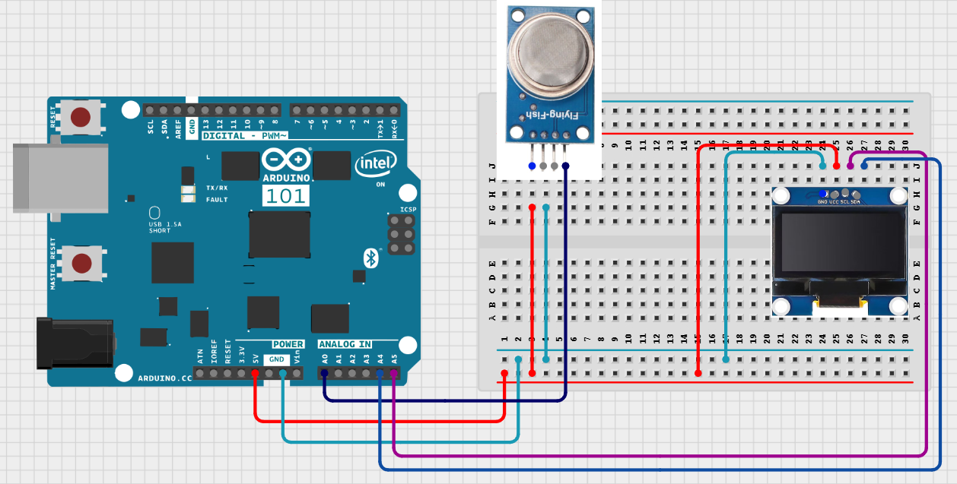
Lab S3: Air Quality Sensor with OLED
Step 3:
Make the OLED connections

Slide 21
Lab S3: Air Quality Sensor with OLED
Code for Lab S3 (Breadboard)
setup()
Start Serial communication
Initialize the OLED display (I2C at address 0x3C)
Clear screen and show title: “MQ135 Air Quality”
Pause for 2 seconds
loop()
Read analog value from MQ135 sensor on A0
Clear the OLED screen
Display “Sensor Value:” and the current reading
(Optional) Convert raw reading to meaningful units (requires calibration)
Refresh OLED display
Wait 1 second before next reading
Overall Flow
MQ135 senses air quality and outputs an analog voltage
Arduino reads this value
OLED continuously displays updated sensor readings
Code for Lab S3 (03_Sensors_Kit_Gas_Sensor.ino):
https://github.com/info-zas/Training/tree/main/GPREC/01_Sensors/01_SensorsCode/03_Sensors_Kit_Gas_Sensor

Slide 22
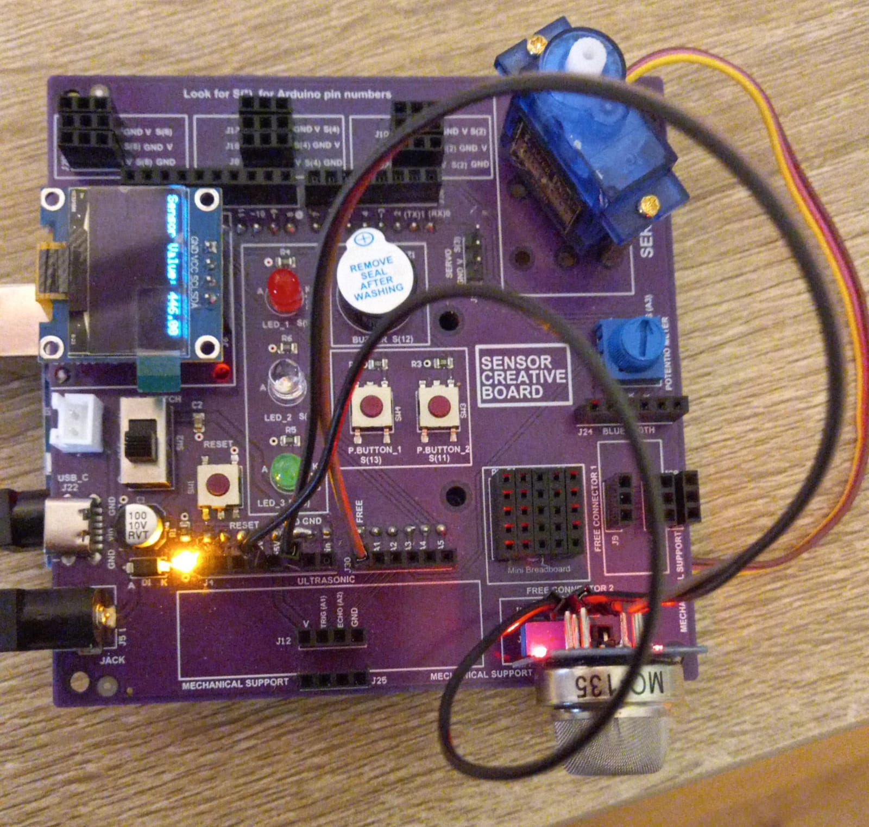
Lab S3: Air Quality Sensor with OLED
Creative board:
Gas Sensor in J11
OLED at J6
Code for Lab S3 (03_Sensors_Kit_Gas_Sensor.ino):
https://github.com/info-zas/Training/tree/main/GPREC/01_Sensors/01_SensorsCode/03_Sensors_Kit_Gas_Sensor

Slide 23


Sensor Kit –Further Labs
So far using sensor kit, we have demonstrated how to use two sensors (Ultrasonic, Air Quality) and OLED display.
With the components in the sensor kit, we can do:
Sensor Creative Board
All the details can be found at Git hub repository:
https://github.com/info-zas/zas-robotics-sensors

Slide 24
Summary
In this presentation, we explored Sensor Kit – The First Kit in the ZAS Robotics Foundational Series
We explored a variety of sensors, understand how they work, and learn how to read and display sensor data.
Labs Covered:
Lab S1: Ultrasonic Sensor (HC-SR04)
Lab S2: Ultrasonic Sensor (HC-SR04) with OLED
Lab S3: Air Quality Sensor (MQ135) with OLED
Next in the Series: Motion Kit – building on sensors by introducing motors, movement, and actuator control.

